Slide 1
SALAM CLUB 25TH ANNIVERSARY
1993 - 2018

Slide 2
1993 THE FOUNDERS
THE FIRST PRESIDENT
The Late Mr. Butrus Pio

Slide 3
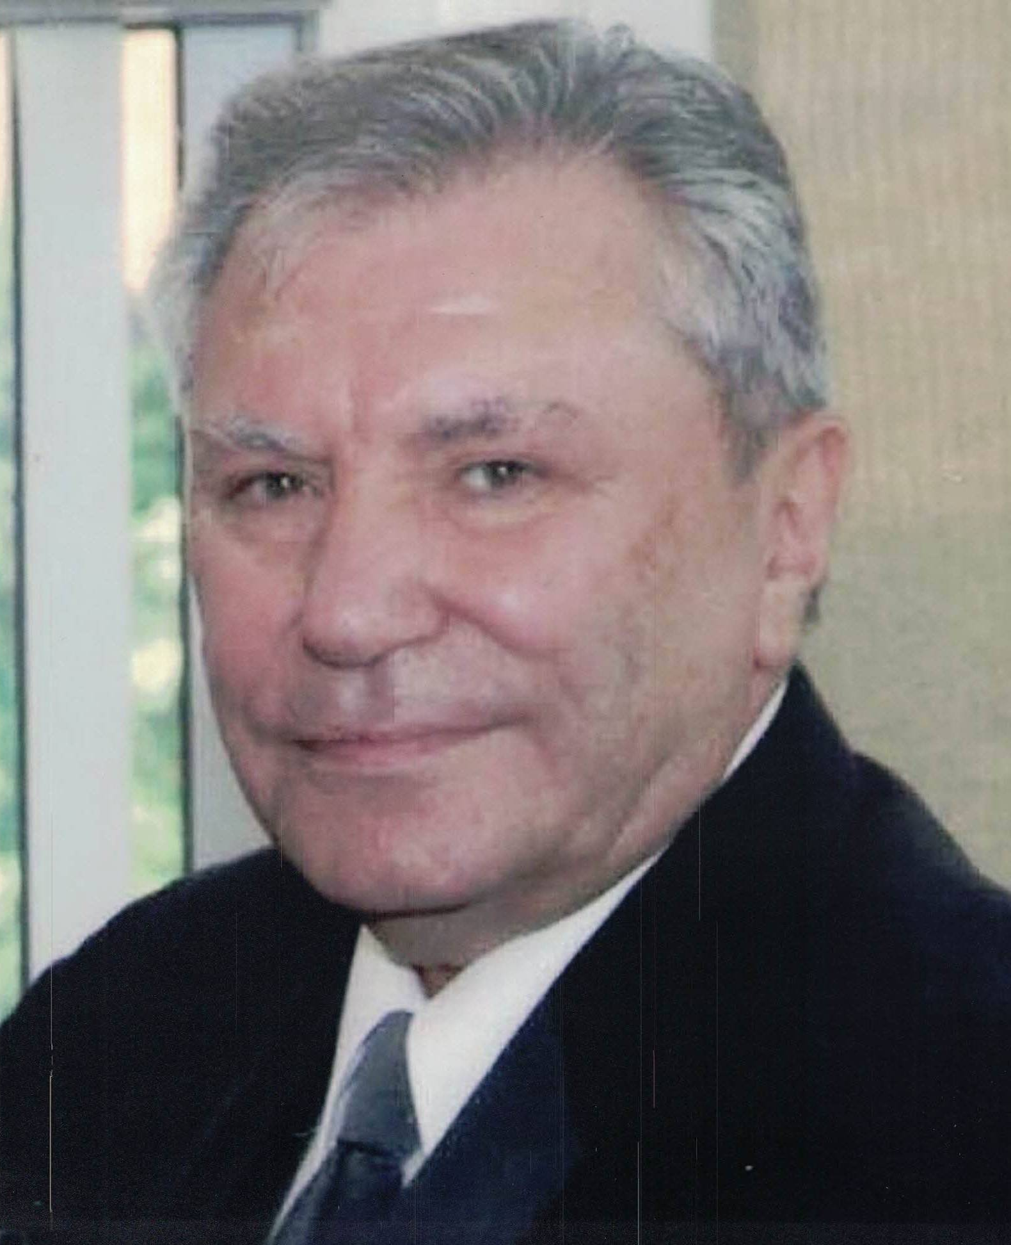
1993 THE FOUNDERS
EXECUTIVE COMMITTEE
The Late Mr. Jamal Ramani

Slide 4
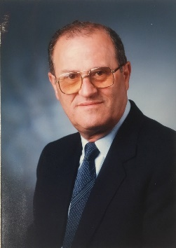
1993 THE FOUNDERS
EXECUTIVE COMMITTEE
The Late Dr. Behnam Al-Saigh

Slide 5
1993 THE FOUNDERS
EXECUTIVE COMMITTEE
Mr. Jan Khayat

Slide 6
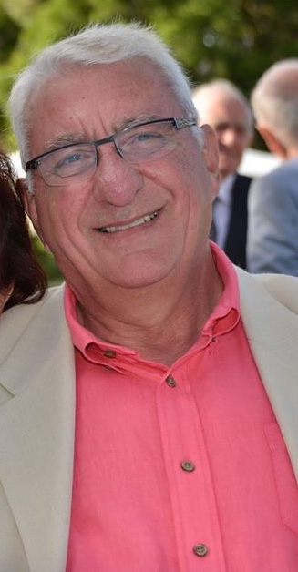
1993 THE FOUNDERS
EXECUTIVE COMMITTEE
Mr. Claude Pio

Slide 7
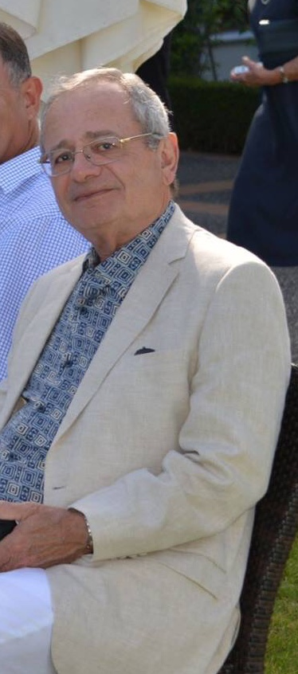
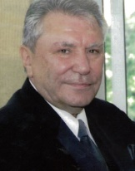
1993 THE FOUNDERS
EXECUTIVE COMMITTEE
Mr. Husam Elowe

Slide 8
1993 THE FOUNDERS
EXECUTIVE COMMITTEE
Mr. Claude Demarchi

Slide 9
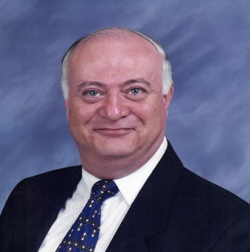
Presidents & Executive members 1993 – 1996
The Late Mr. Butrus Pio (President)
The Late Mr. Jamal Ramani | The Late Dr. Behnam Al-Saigh | Mr. Jan Khayat | Mr. Salah Al-Saigh
Mr. Claude Demarchi | Mr. Husam Elowe | Mr. Sajid Lewis | Mr. Ahsan Zayouna

Slide 10
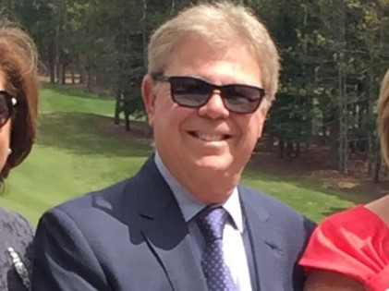
Presidents & Executive members 1996 – 1998
The Late Mr. Jamal Ramani (President)
The Late
Mr. Ahsan Zayouna | Mr. Claude Demarchi | Mr. Nail Aziz | Mr. Raad Georgie | Mrs. Diko Abachi
Mrs. Naimet Thomas | Mr. Wisam Al-Sayegh |  | Mr. Claude Pio | Mr. Khalid Yassi

Slide 11
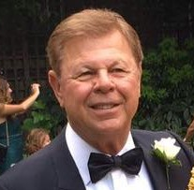
Presidents & Executive members 1998 – 2000
The Late Mr. Jamal Ramani (President)
Mr. Ahsan Zayouna | Mr. Claude Demarchi | Mr. Munther Gabriel | Mr. Khalid Yassi | Mrs. Naimet Thomas
Mrs. Diko Abachi | Mr. Raad Georgie |  | Mr. Kamal Killu | Mr. Nail Aziz

Slide 12
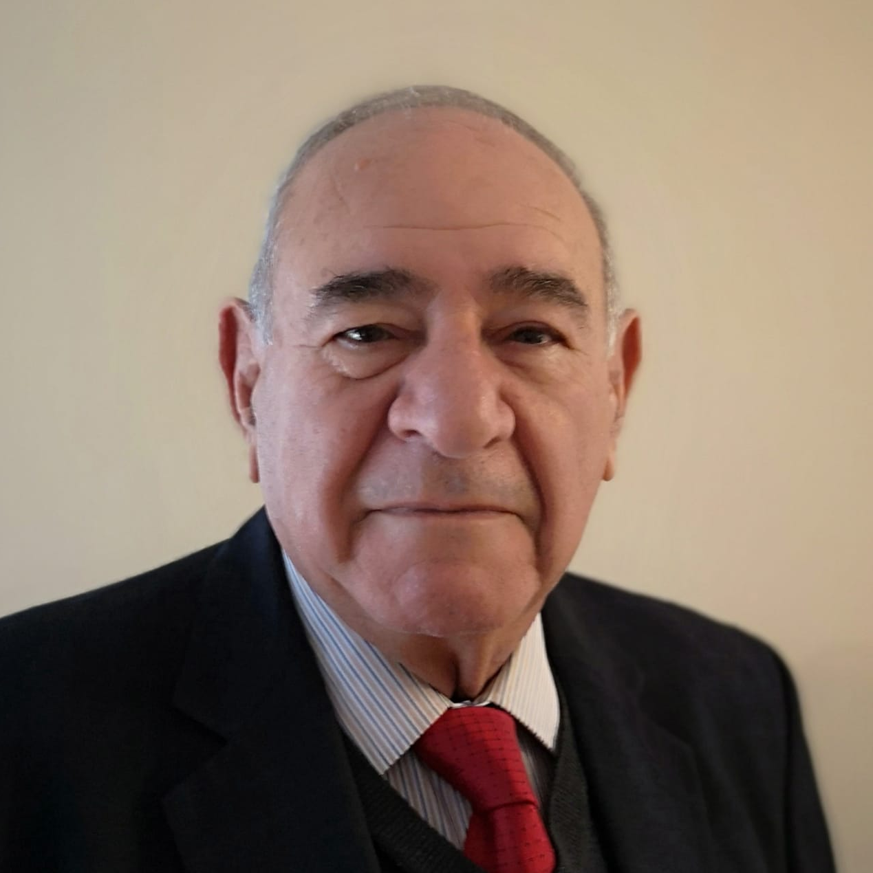
Presidents & Executive members 2000 – 2002
Mr. Suhair Khayat (President)
Mr. Claude Demarchi | Mrs. Diko Abachi | Mr. Jan Khayat | Mrs. Liza Lewis | Mr. Waleed Gulli | Mrs. Suad Andrews
Mr. Nabil Salman | Mr. Haraj Melkonian | Mr. Sabah Attisha | Mr. Joe Raffi | Mr. Janan Jibran

Slide 13
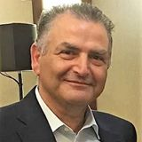
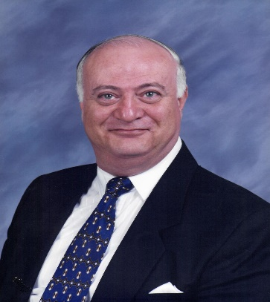
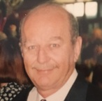
Presidents & Executive members 2002 – 2004
Mr. Munther Gabriel (President)
Mr. Rabi Allos | Mr. Nabil Salman | Mr. Jan Khayat | The Late Mr. Tariq Hindo | Mr. Waleed Gulli
Mr. Nazar Hindi | Mr. Janan Iskandar | The Late Mr. Adil Shamon | Mr. Tariq Toma

Slide 14
Presidents & Executive members 2004 – 2007
Mr. Munther Gabriel (President)
Mr. Rabi Allos | Mr. Nabil Salman | Mrs. Layla Nasri | Mrs. Diko Abachi | Mrs. Souad Andrews
Mr. Khalid Yassi | Mr. Sami Shabo | Mr. Waleed Gulli | The Late Mr. Adil Shamon | Mr. Tariq Toma

Slide 15
Presidents & Executive members 2007 – 2009
Mr. Munther Gabriel (President)
Mr. Rabi Allos | Mr. Khalid Yassi | Mrs. Layla Nasri | Mrs. Diko Abachi | Mrs. Souad Andrews
Mr. Haraj Melkonian | Mr. Waleed Gulli | Late Mr. Adil Shamon | Mr. Tariq Toma

Slide 16
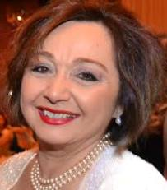
Presidents & Executive members 2009 – 2011
Mr. Munther Gabriel (President)
Mr. Rabi Allos | Mr. Khalid Yassi | Mrs. Layla Nasri | Mrs. Diko Abachi | Mrs. Souad Andrews
Mr. Haraj Melkonian | Mrs. Aeda Naami | Mrs. Dina Saour | Mr. Basil Haddad

Slide 17
Presidents & Executive members 2011 – 2014
Mr. Khalid Yassi (President)
Mr. Rabi Allos | Mr. Waleed Shukur | Mr. Vahe Minas | Mrs. Dina Saour | Mrs. Souad Andrews
Mr. Tariq Toma | Mrs. Haifa Butti | Mr. Salwan Hannoudi | Mr. Basil Haddad | Late Mr. Adel Shamoun

Slide 18
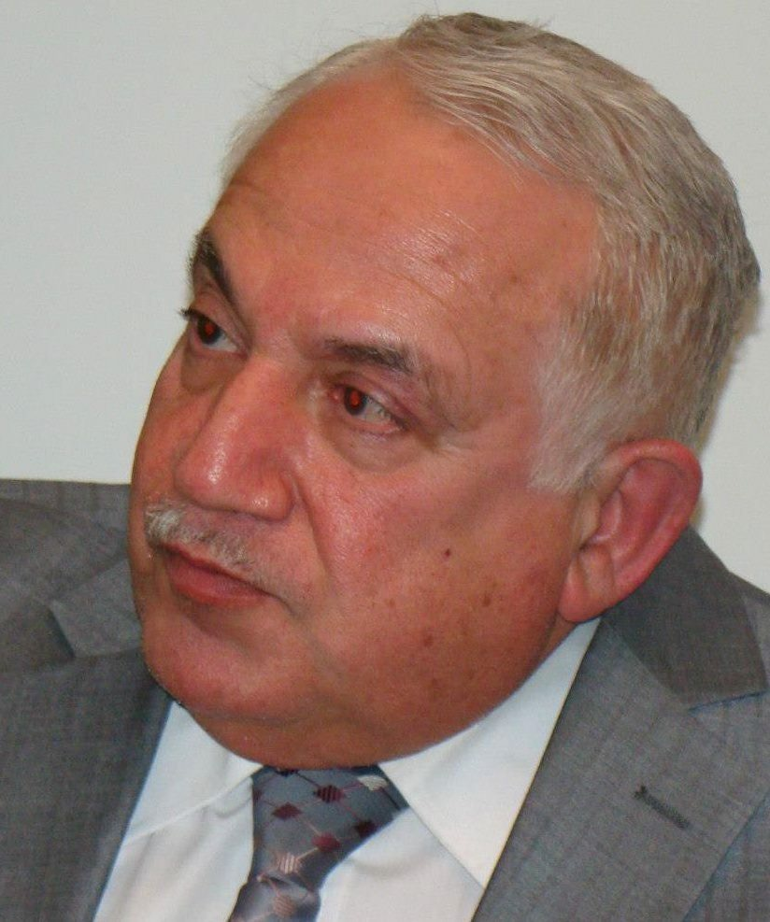
Presidents & Executive members 2014 – 2016
Mr. Khalid Yassi (President)
Dr. Nazar Mitaiti | Mr. Waleed Shukur | Mrs. Nada Ghazala | Mrs. Reta Setrak | Mrs. Dina Saour
Mr. Sinan Dakkak | Mr. Salwan Hanoudi | Mr. Vahe Minas | Mr. Raad Iskander

Slide 19
Presidents & Executive members 2016 – 2018
Dr. Nizar Mitaiti (President)
Mrs. Nathira Saour (President)
Mr. Khalid Yassi | Mr. Adil Toma | Mr. Shakir Shakouri | Mr. Saad Georgie
Mrs. Sahab Numan | Dr. Nadia Jajawi | Mr. Khalid Mirza | Mr. Emil Alexander

Slide 20
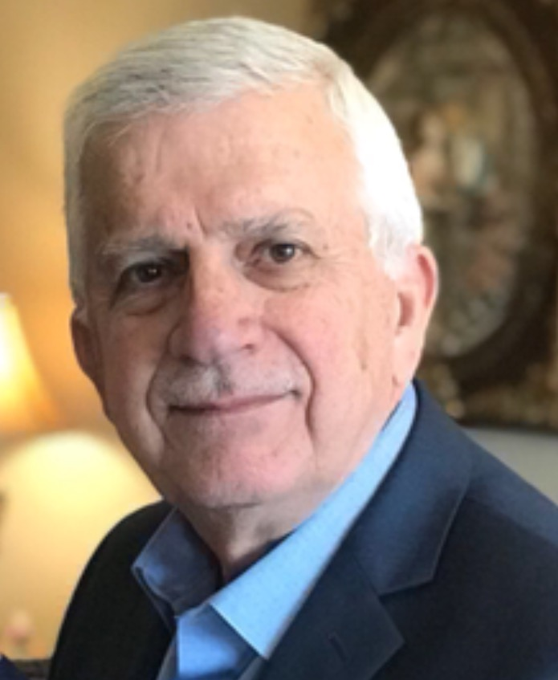
Presidents & Executive members 2018 – 2020
Mrs. Nathira Saour (President)
Mrs. Berthe Ramani | Mr. Emil Alexander | Mr. Saad Georgie | Mr. Ihsan Zayouna
Mr. Khalid Mirza | Mr. Shakir Shakouri | Mr. Adil Toma | Mr. Walid Batta

Slide 21
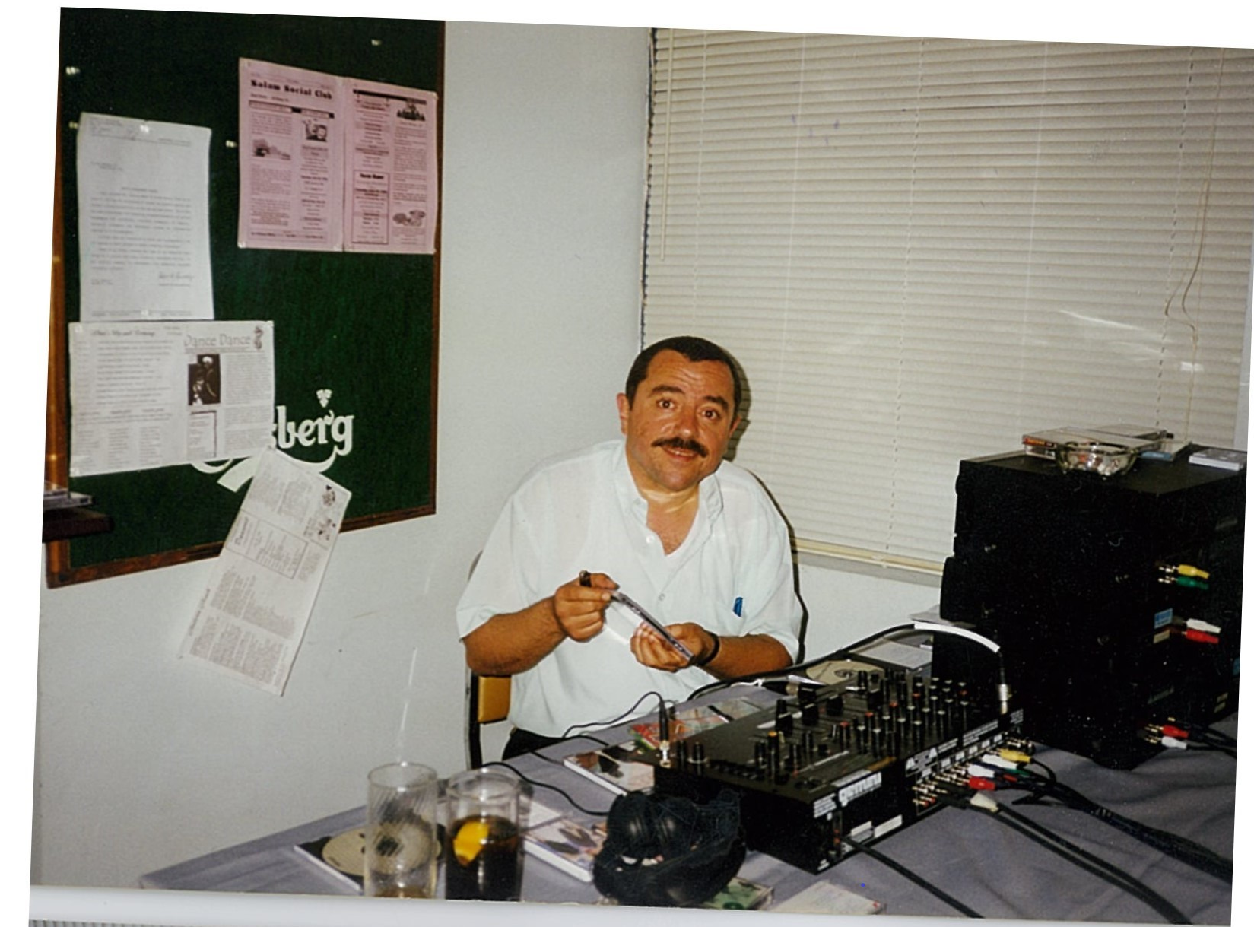
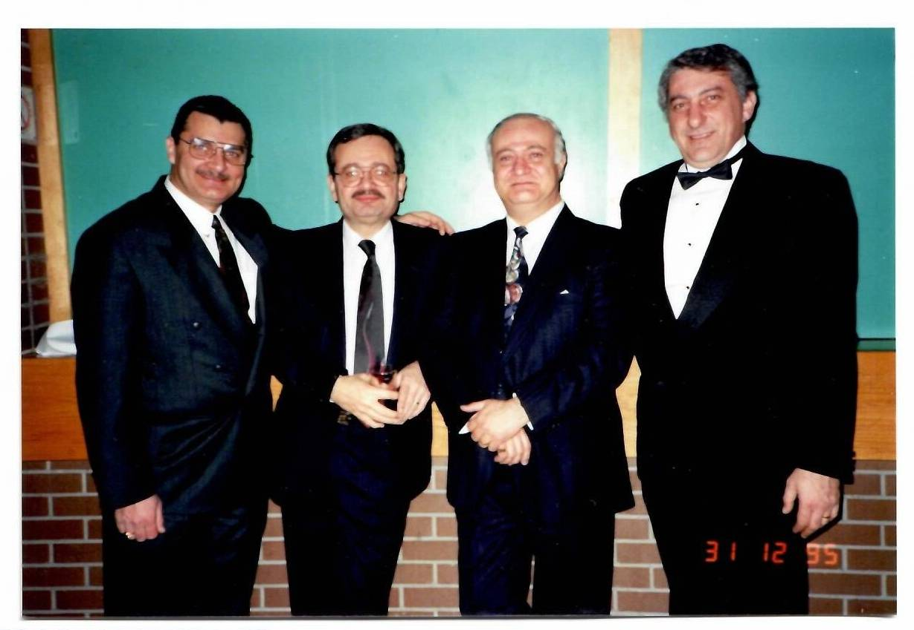
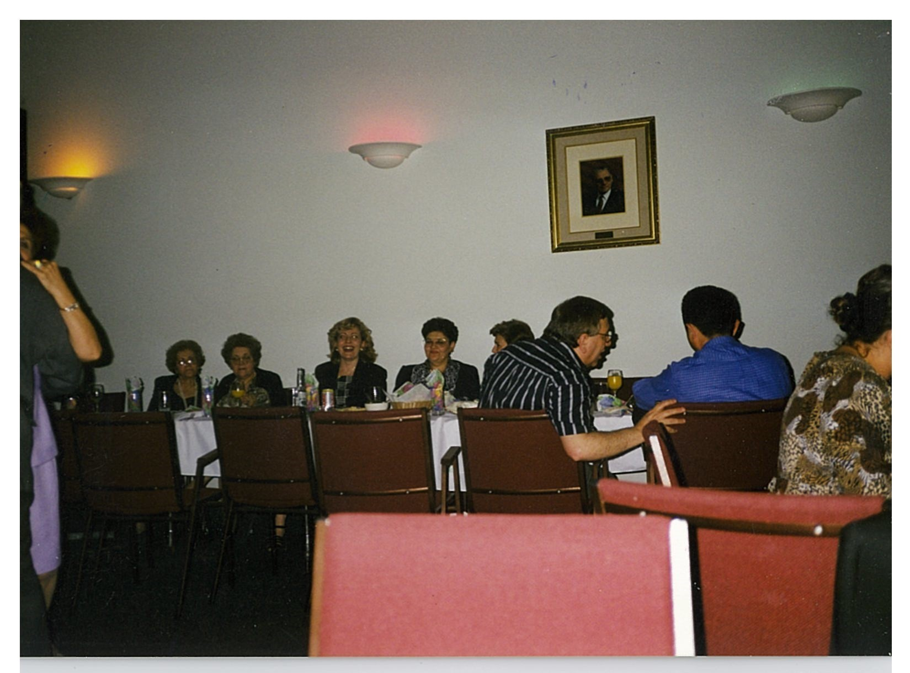
Miscellaneous club activities 1993 –2000 167 APPLEWOOD CRES.

Slide 22
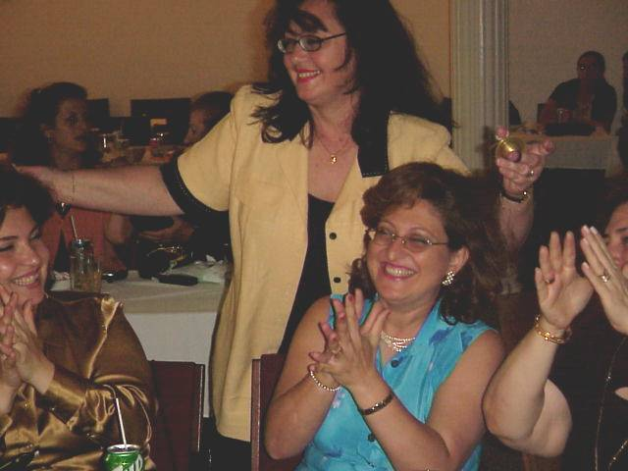
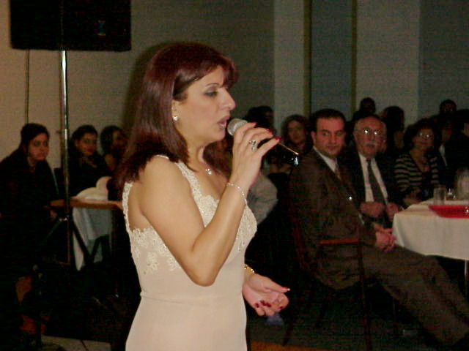

Slide 23
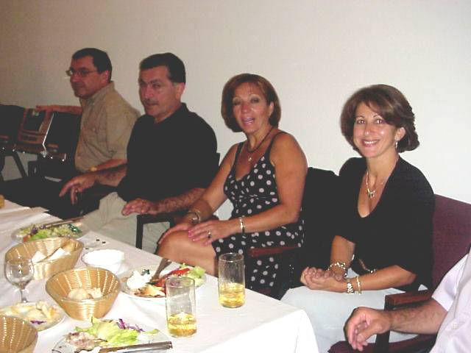
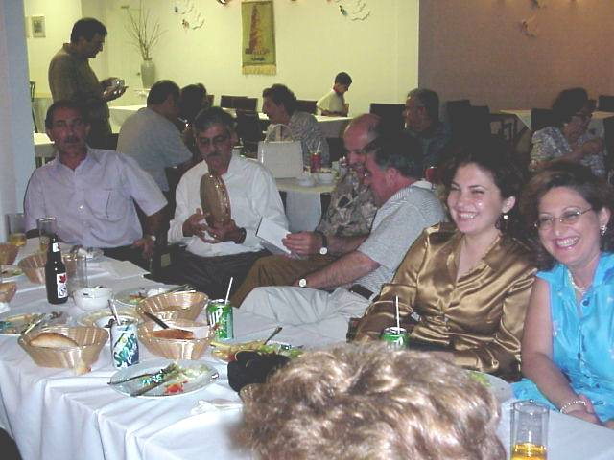
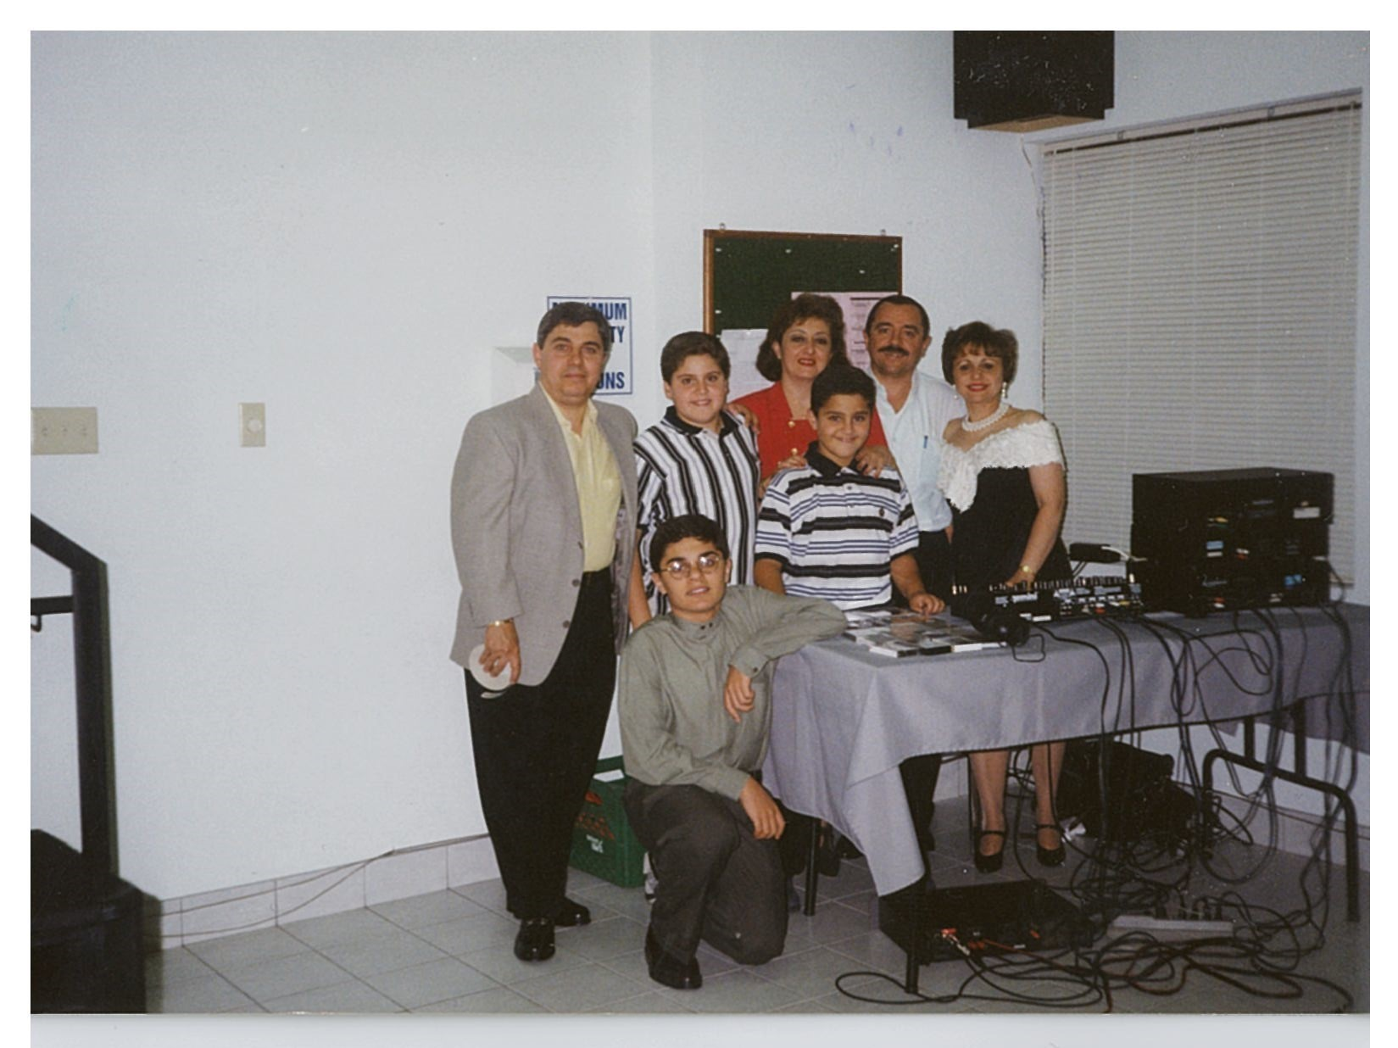

Slide 24
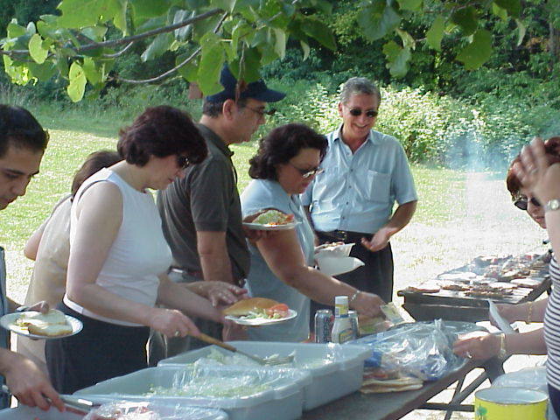
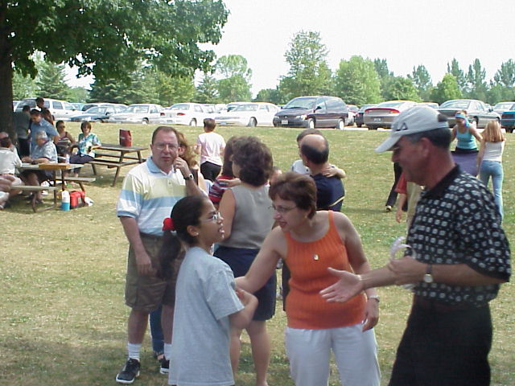
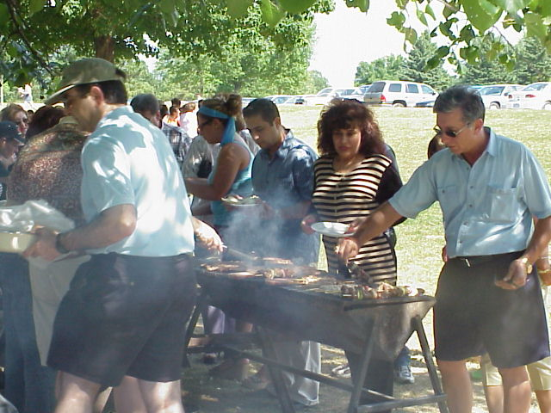

Slide 25
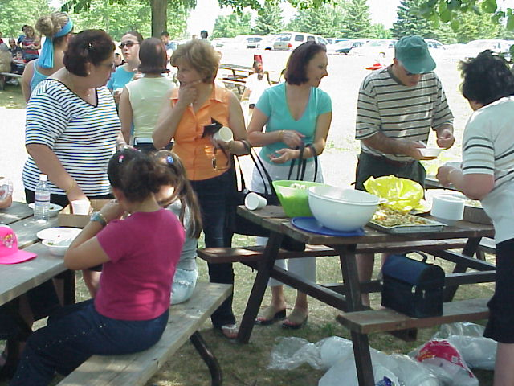
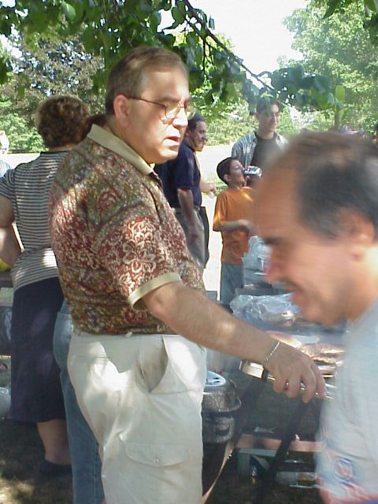
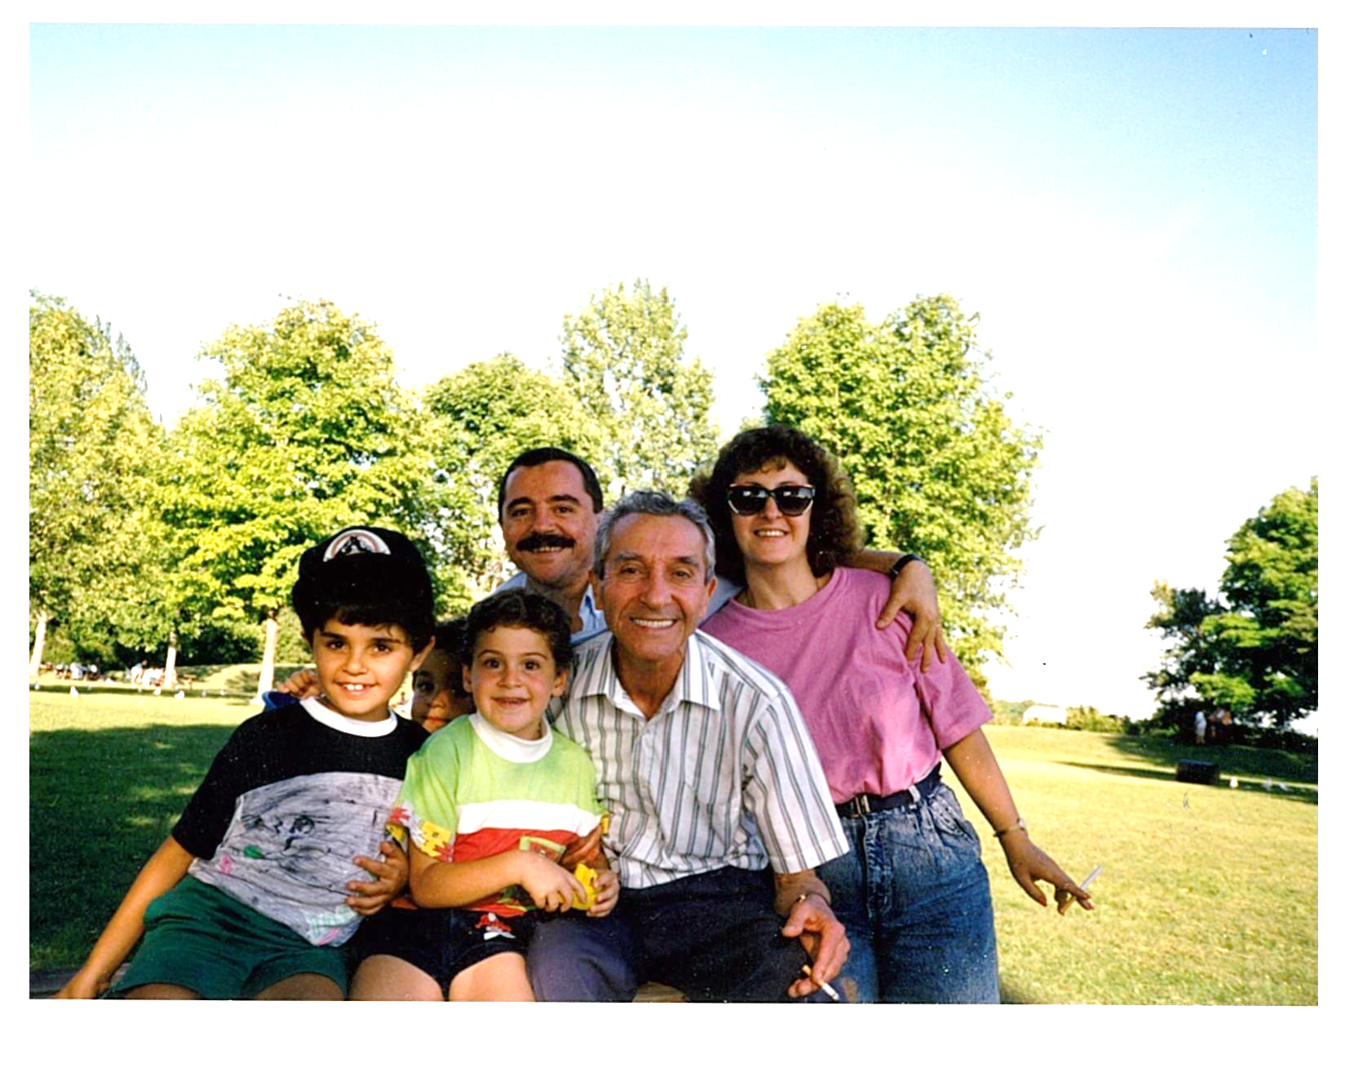
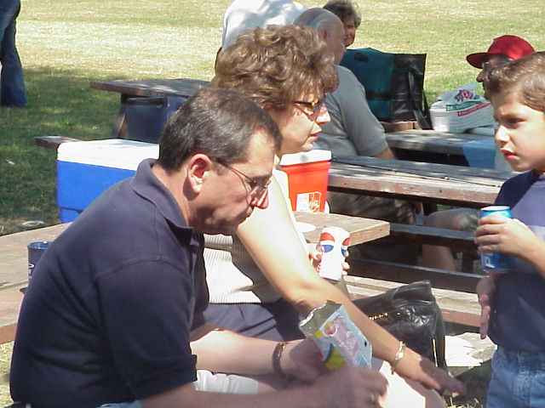
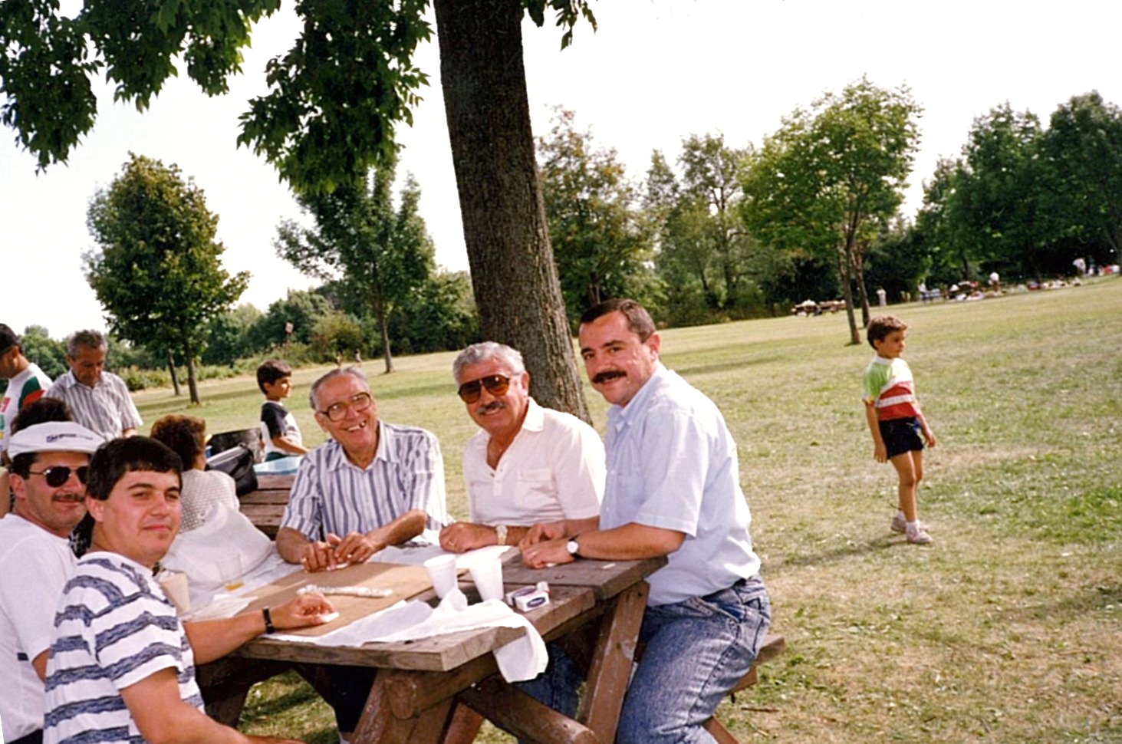
FUN TIME

Slide 26
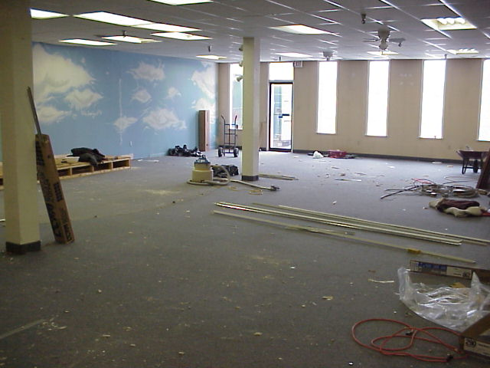
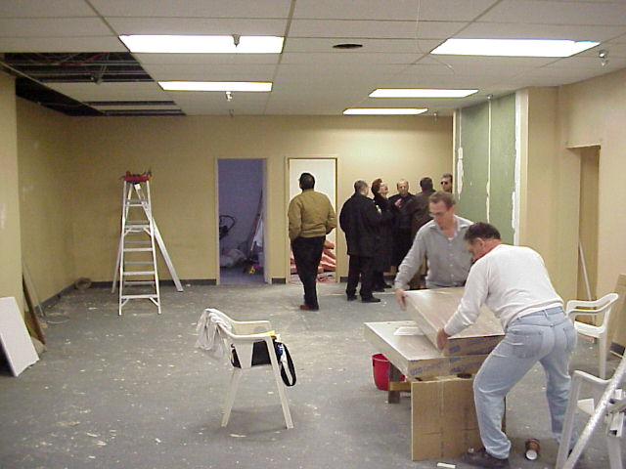
Miscellaneous club activities 2000 –2018 RENOVATIONs OF 120 NORFINCH

Slide 27
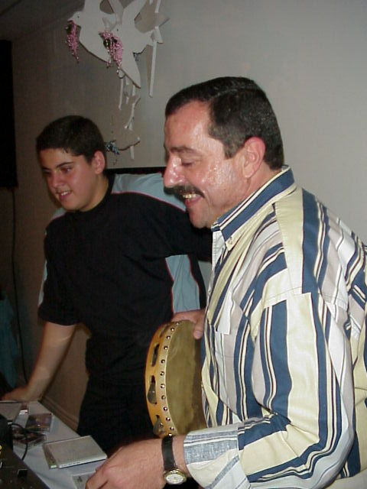
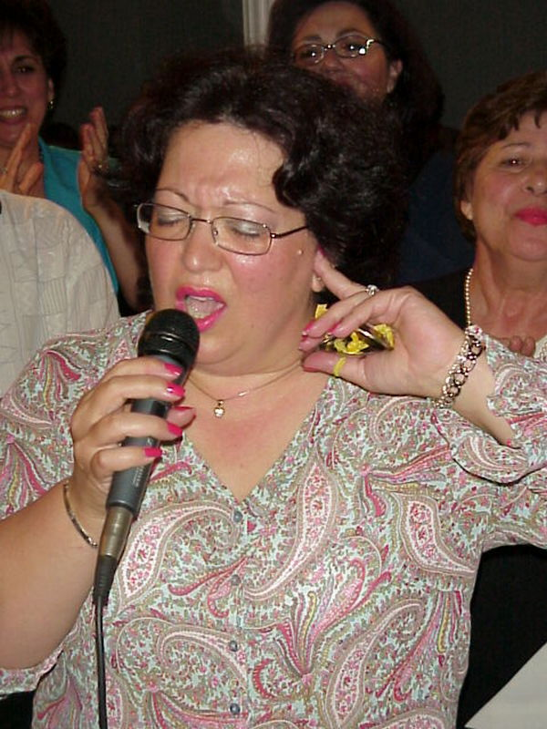
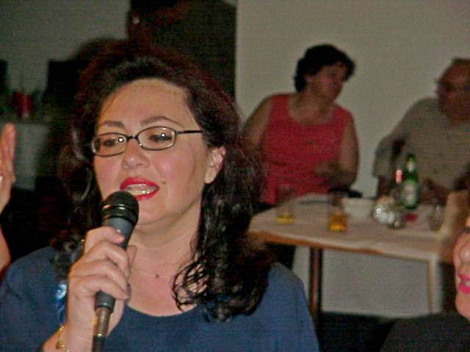

Slide 43
AND FINALLY OUR 25TH ANNIVERSARY CELEBRATION NOVEMBER 10^{TH.} 2018

